Slide 1
Module Seven: Hot topics in Service Computing - Cloud -

Slide 2
Topic 4: Virtualization

Slide 3
Intended learning outcomes
After completing this topic, you will be able to:
Discuss system, network and storage virtualization and outline their role in enabling the cloud computing system model

Slide 4
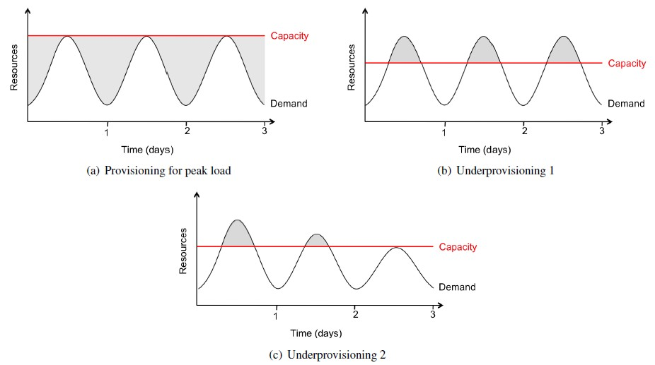
Resource Provisioning problems - Company's/Customer's View
Resource Wastage
Unserved Requests
Loss of Customers
Big Headache

Slide 5
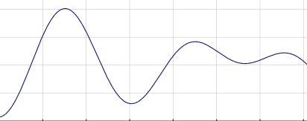
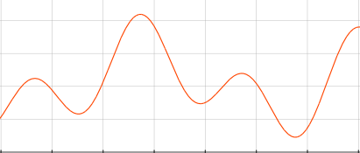
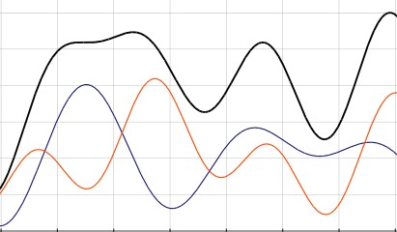
Resource Provisioning – Data Center/Cloud Provider's View
2000 2050
0
0
Company ­ BLUE
Company ­ RED
Consider the Data Center or a Cloud provider that needs to serve 2 customers with the following needs:
Peak demand of the “Company BLUE” customer is 2000 machines
Peak demand of the “Company RED” customer is 2050 machines
3000
0
Cloud Provider

Slide 6
Resource Provisioning – Data Center/Cloud Provider's View
2000 2050
0
0
Company ­ BLUE
Company ­ RED
3000
For the Data Center, or the Cloud provider, to serve these 2 customers, there is a need to provide 4050 machines
0
Cloud Provider

Slide 7
Resource Provisioning – DataCenter/Cloud Provider's View
2000 2050
0
0
Company ­ BLUE
Company ­ RED
3000
However, the peak demands of the two customers is not at the same time
Some machines can be used to serve both customers at different times
0
Cloud Provider

Slide 8
Resource Provisioning – Data Center/Cloud Provider's View
2000 2050
0
0
Company ­ BLUE
Company ­ RED
3000
The black line shows the number of machines needed to meet the demand from the both customers at any given time
Maximum 3000 machines are needed to meet the demand
0
Cloud Provider

Slide 9
Resource Provisioning – DataCenter/Cloud Provider's View
2000 2050
0
0
Company ­ BLUE
Company ­ RED
3000
- Charge for 4050 machines, work with 3000
- Good business
- Computing as a service or utility
0
Cloud Provider

Slide 10
Cloud Computing requirements
Scaling infrastructure on demand within minutes or even seconds, instead of days or weeks, thereby avoiding under­utilization (idle servers) and over­utilization
Accessing resources and services needed to perform functions with dynamically changing needs

Slide 11
Virtualization definition (1)
Virtualization is the creation of a virtual (rather than physical) version of something, such as
an operating system
a server
a storage device
or network resources.
It hides the physical characteristics of a resource from users, instead showing another abstract resource.

Slide 12
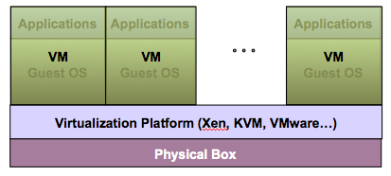
Virtualization Architecture
Multiple virtual machines (VMs) can run on a single physical system
Guest OS assumes complete control of the underlying hardware
Virtualization architecture provides this illusion through virtualization platform

Slide 13
Virtual machine
A Virtual machine (VM) is a software implementation of a machine (i.e. a computer) that executes programs like a real machine
VM is an isolated runtime environment (guest OS and applications)

Slide 14
Host vs guest
Host (Target)
The primary environment - the machine on which the virtual machine is created
Guest (Source)
The virtualized environment

Slide 15
Virtualization platform
Other names
Hypervisor
Virtual machine manager (VMM)
Virtual machine monitor (VMM)
Virtualization manager
A software layer which provides virtualization:
Allows multiple Guest OS to run simultaneously on a single physical host
Provides hardware abstraction to the running Guest OSs and efficiently multiplexes underlying hardware resources.

Slide 16
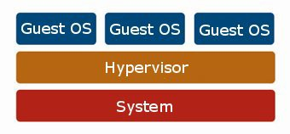
Virtualization – resource sharing and isolation
Each guest OS appears to have the host's processor, memory, and other resources all to itself
However, the hypervisor is actually controlling the host processor and resources
Allocates what is needed to each operating system in turn
Makes sure that the guest operating systems cannot disrupt each other
Hardware

Slide 17
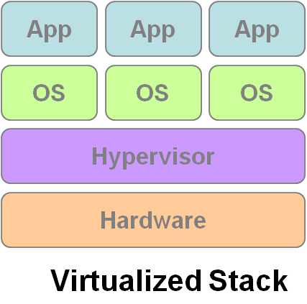
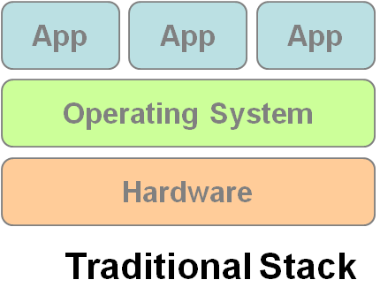
Virtualization
VM1
VM2
VM3

Slide 18
Benefits of Virtualization
Sharing of resources helps cost reduction
Isolation: Virtual machines are isolated from each other as if they are physically separated
Encapsulation: Virtual machines encapsulate a complete computing environment
Hardware independence: Virtual machines run independently of underlying hardware
Portability: Virtual machines can be migrated between different hosts.

Slide 19
Virtualization in Cloud Computing
Cloud computing takes virtualization one step further:
You don’t need to own the hardware
Resources are rented as needed from a cloud
Various providers allow creating virtual servers:
Choose the OS and software each instance will have
The chosen OS will run on a large server farm
Can instantiate more virtual servers or shut down existing ones within minutes
You get billed only for what you used

Slide 20
Importance of Virtualization in Cloud Computing
Cloud can exist without Virtualization, although it will be difficult and inefficient
Cloud makes notion of “Pay for what you use”, “infinite availability- use as much you want”
These notions are practical only if we have
lots of flexibility
efficiency in the back-end
This efficiency is readily available in Virtualized Environments and Machines
Virtualization is the foundation which supports cloud computing

Slide 21
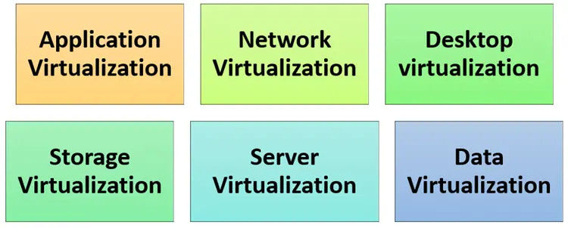
Types of Virtualizations

Slide 22
Types of Virtualizations

Slide 23
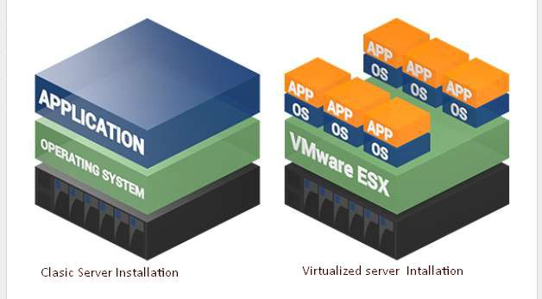
Server Virtualization
When the hypervisor is directly installed on the server system

Slide 24
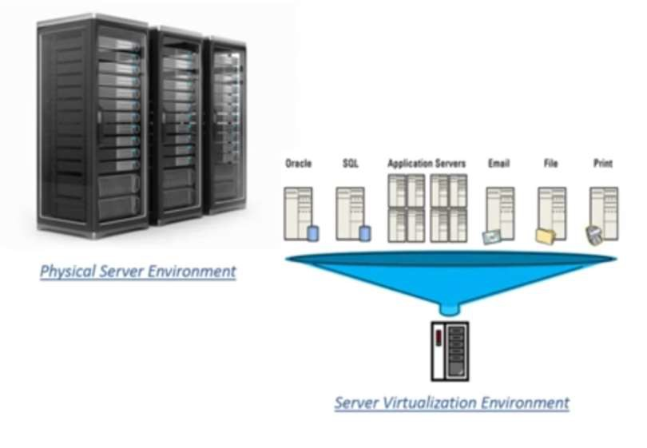
Server Virtualization
A single physical server can be divided into multiple servers
on the demand basis
for balancing the load

Slide 25
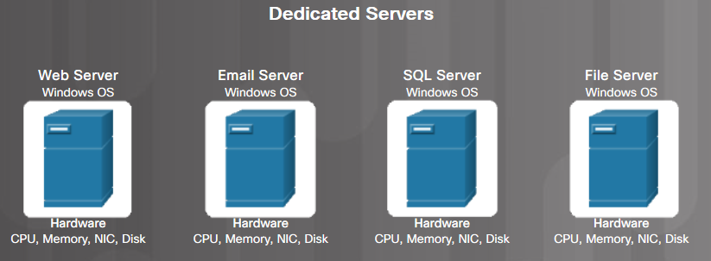
Traditional Server Deployment
Traditionally, organizations delivered applications and services using powerful dedicated servers.
These dedicated servers are equipped with large amounts of RAM, powerful CPUs, and multiple large storage devices.
Disadvantages include: wasted resources, single-point of failure, and server sprawl.

Slide 26
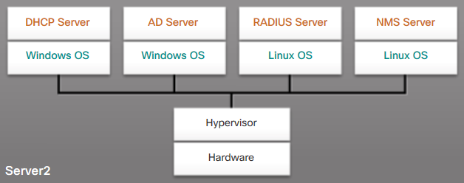
Server Virtualization
Server virtualization takes advantage of idle resources to reduce the number of servers required

Slide 27
Advantages of Server Virtualization
Better use of resources
Less space required
Less energy consumed
Reduced cost
Faster server provisioning
Maximize server uptime
Improved disaster recovery
Support for legacy systems

Slide 28
Hypervisor Types
Type 1 – Bare metal
Hypervisors run directly on the host's hardware as a hardware control and guest operating system monitor
Type 2 – Hosted
Hypervisors are software applications running within a conventional operating system

Slide 29
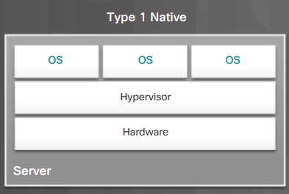
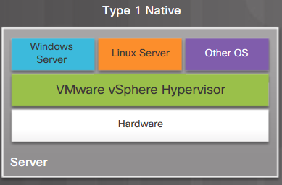
Type 1 Hypervisors
Type 1/bare metal/native
Typically used with server virtualization
For example, they are used in data centers and cloud computing
Run directly on the hardware of a host, and manage the allocation of system resources to VMs

Slide 30
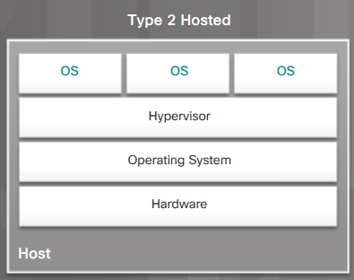
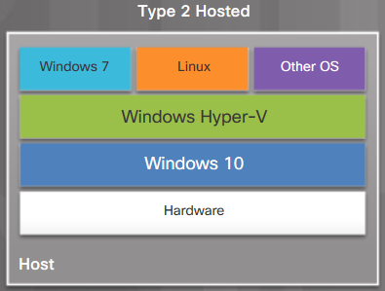
Type 2 Hypervisors
Type 2/hosted
Commonly used with client-side virtualization.
Type 2 hypervisors work with the host computer to create and use multiple VMs

Slide 31
Containerization
OS level virtualization + Application level virtualization = Containerization

Slide 32
Containers
The containers are basically a fully functional and portable cloud or non-cloud computing environment surrounding the application and keeping it independent from other parallelly running environments
Individually each container simulates a different software application and runs isolated processes by bundling related configuration files, libraries and dependencies
But, collectively multiple containers share a common OS Kernel
In recent times, the containerization technology has been widely adopted by Amazon Web Services, Microsoft Azure, Google Cloud Platform, and IBM Cloud

Slide 33
Types of containers
OS containers
Apps containers

Slide 34
Container management, orchestration, clustering
Container orchestration or container management is mostly used in the context of application containers
Implementations providing such an orchestration include Kubernetes and Docker swarm and others

Slide 35
Kubernetes
Kubernetes is an open-source container orchestration system for automating software deployment, scaling, and management
Google originally designed Kubernetes (announced in mid-2014)
The Cloud Native Computing Foundation now maintains the project

Slide 36
Kubernetes distributions
Various vendors offer Kubernetes-based platforms or infrastructure as a service (IaaS) that deploy Kubernetes
Alibaba Cloud ACK (Alibaba Cloud Container Service for Kubernetes)
Amazon EKS (Elastic Kubernetes Service)
DigitalOcean managed Kubernetes Service
Google GKE (Google Kubernetes Engine)
IBM Cloud Kubernetes Services
Microsoft AKS (Azure Kubernetes Services)
Mirantis K0s
Oracle Container Engine for Kubernetes
Red Hat Openshift
SUSE Rancher Kubernetes Engine (RKE)
VMware Tanzu

Slide 37
Docker
Docker is a set of platform as a service (PaaS) products that use OS-level virtualization to deliver software in packages called containers

Slide 38
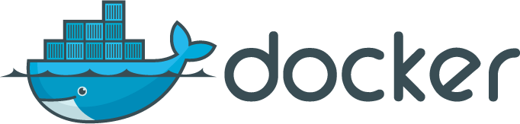

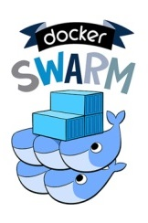
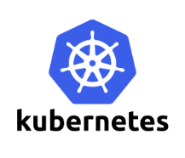

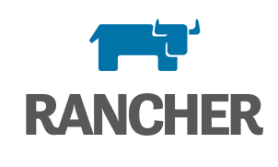
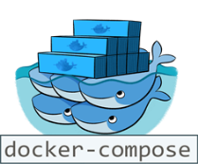
Container Technologies
Containers
Light-weight OS/application-layer virtualization
Isolation: From other Apps and OS
Portability: Binary, Data, Config, Logs
Container Orchestration
Deploy and manage complex services
Scalability and high-availability

Slide 39
Example - CERN core technologies running in containers
Container-based Service Deployment
Containerize and distribute CERN storage services and deploy them on any cloud
CERN - the European Organization for Nuclear Research
a European research organization that operates the largest particle physics laboratory in the world
ScienceBox
The container-based version of CERN services
EOS
CERNBox
SWAN

Slide 40

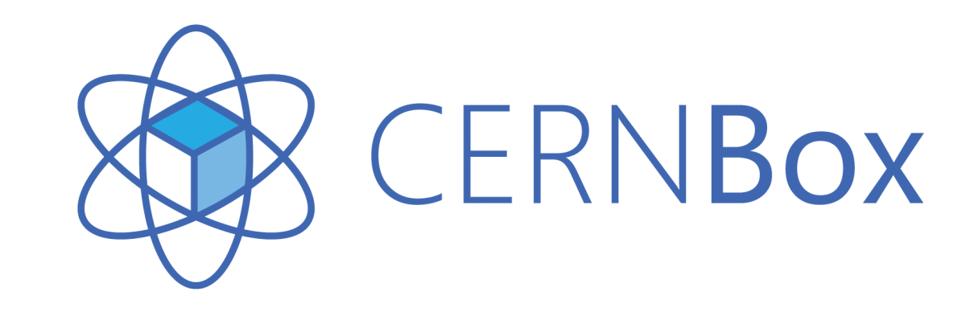
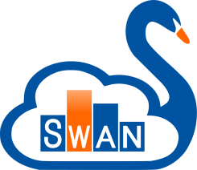
Containerized CERN Technology
Boxed – Scalable Storage Backend for Cloud and HPC (high performance computing)
- Self-contained, Docker-based package with:
EOS: Disk Storage for LHC+physics data, and CERNBox
CERNBox: Cloud Sync&Share for Science
SWAN: Platform for Interactive Data Analysis in the Cloud
CERN IT-ST
CERN IT-ST
CERN IT-ST + EP-SFT

Slide 41
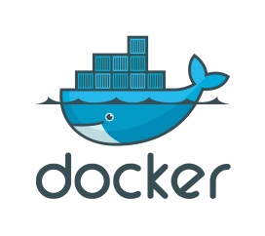
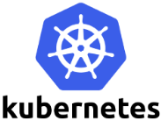
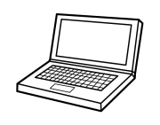

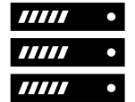
Containerized CERN Technology
ScienceBox – Self-contained, Docker-based package with:
+
+
One-Click Demo Deployment
Production-oriented Deployment
Single-box installation via docker-compose
No configuration required
Download and run services in 15 minutes
https://github.com/sciencebox
Container orchestration with Kubernetes
Scale-out storage and computing
Tolerant to node failure for high-availability

Slide 42
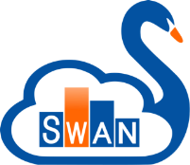
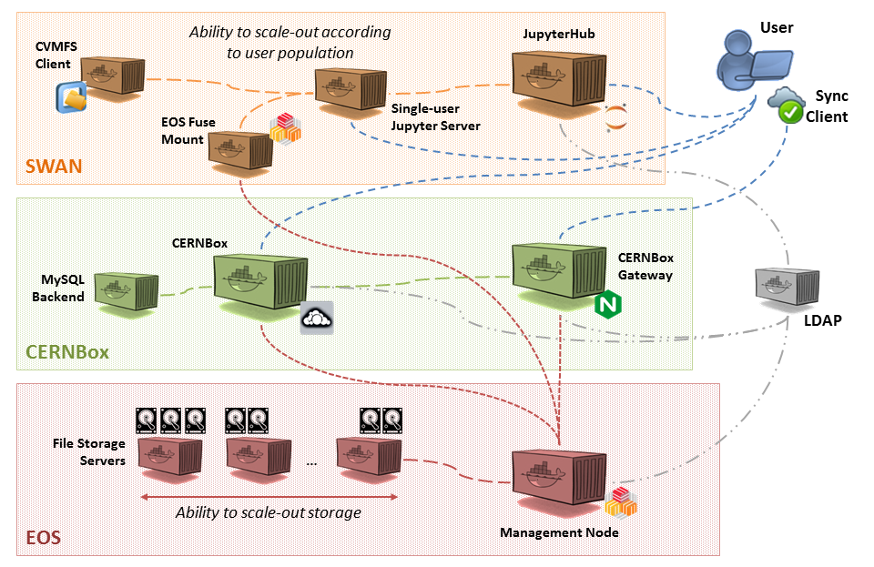


ScienceBox Architecture
SWAN: Platform for Interactive Data Analysis in the Cloud
CERNBox: Cloud Sync&Share for Science
EOS: Disk Storage for LHC+physics data, and CERNBox
https://sciencebox.web.cern.ch/sciencebox/

Slide 43



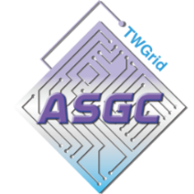

Use Cases for ScienceBox
EU Project Up to University (Up2U)
Simplified try-out and deployment for peers
Australia's Academic and Research Network (AARNET)
Joint Research Centre (JRC), Italy
Saint Petersburg State University, Russia
National Research Center “Kurchatov Institute”, Russia
Disposable deployment for testing and development within IT-ST and EP-SFT groups at CERN
Up2University: Educational Platform with Sync/Share, Peter Szegedi

Slide 44
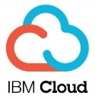

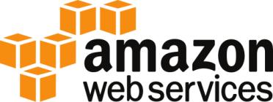


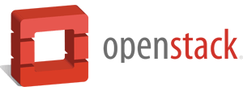
Deployment on Private and Public Clouds
Single-box deployment running on multiple clouds:
Amazon Web Services
Helix Nebula Cloud (IBM, RHEA, T-Systems)
OpenStack Clouds (CERN, GRNet, PSNC)
Your own laptop! (CentOS, Ubuntu)
Production-oriented deployment with Kubernetes
OpenStack at CERN
Poznań Supercomputing and Networking Center (PSNC)

Slide 45
Summary
Discuss virtualization and outline its role in enabling the cloud computing system model

